Slide 1

Satisfaction of Airline

Slide 2
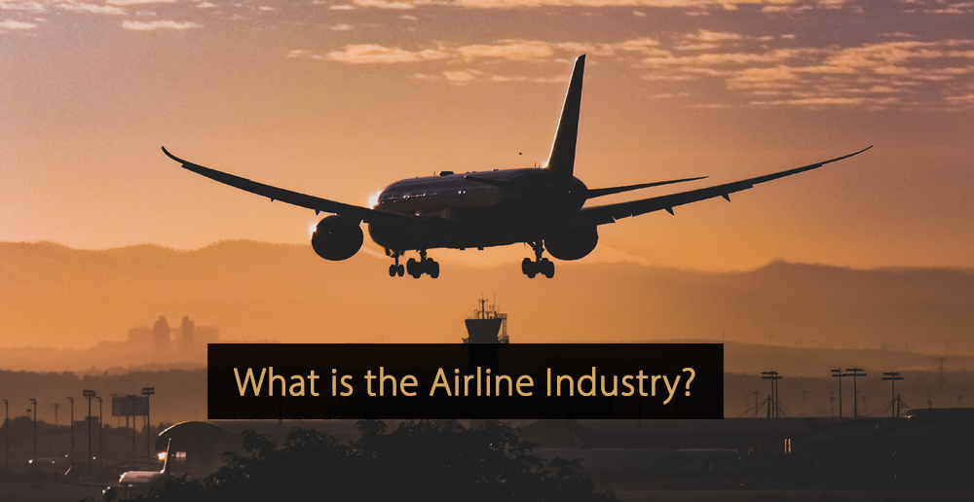
An airline can be defined as a company that offers regular services for transporting passengers or goods via the air. These companies are said to comprise the airline industry, which is also regarded as a sub-sector of the aviation sector and the wider travel industry. In this post, you will learn everything you need to know about airlines.

Slide 3
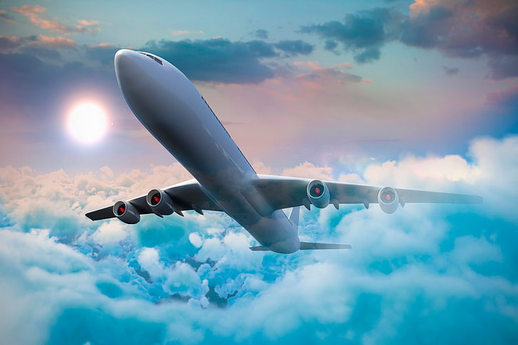
Why are Airlines Important?
It generates economic growth, creates jobs, and facilitates international trade and tourism.

Slide 4

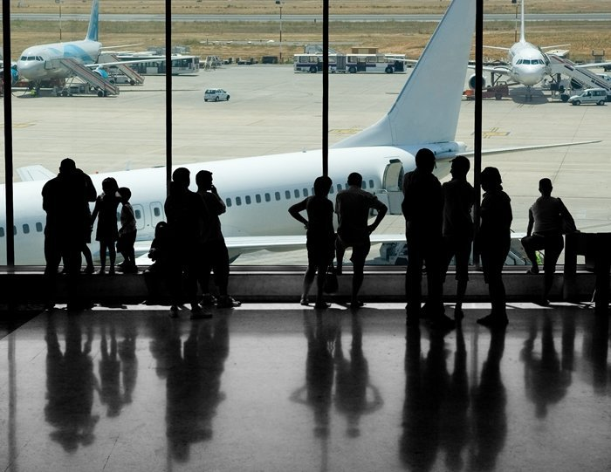
?

Slide 5

How is satisfaction related to flight distances and age demographics?

Slide 6
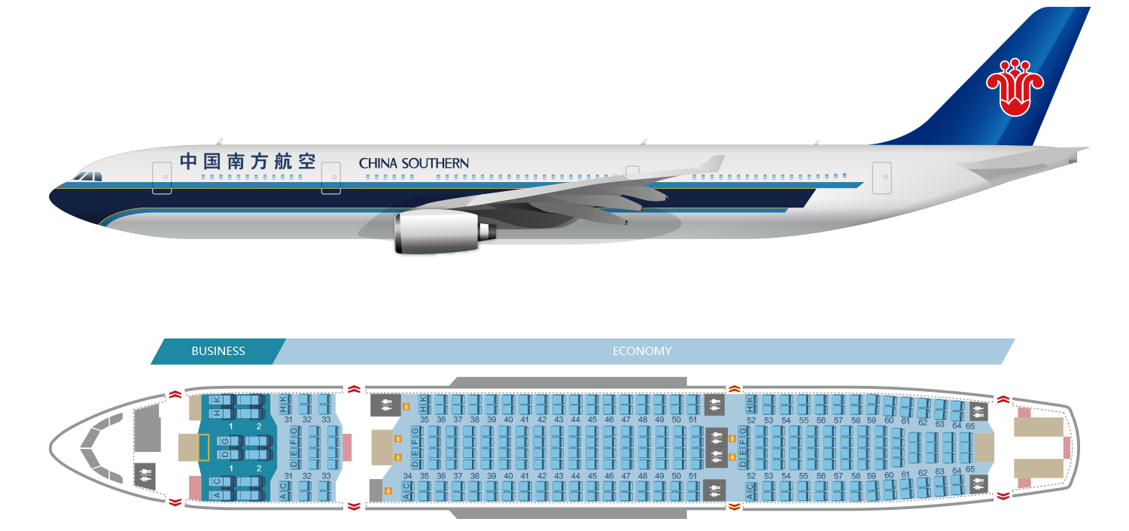
How does Class of Airline Different the Satisfaction of the Customer ?

Slide 7
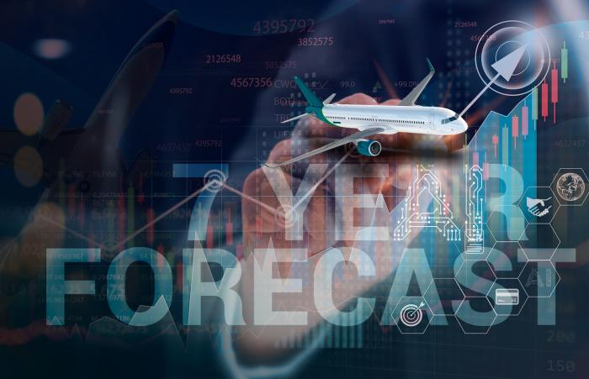
How does overall satisfaction compare between loyal and disloyal customers?

Slide 8
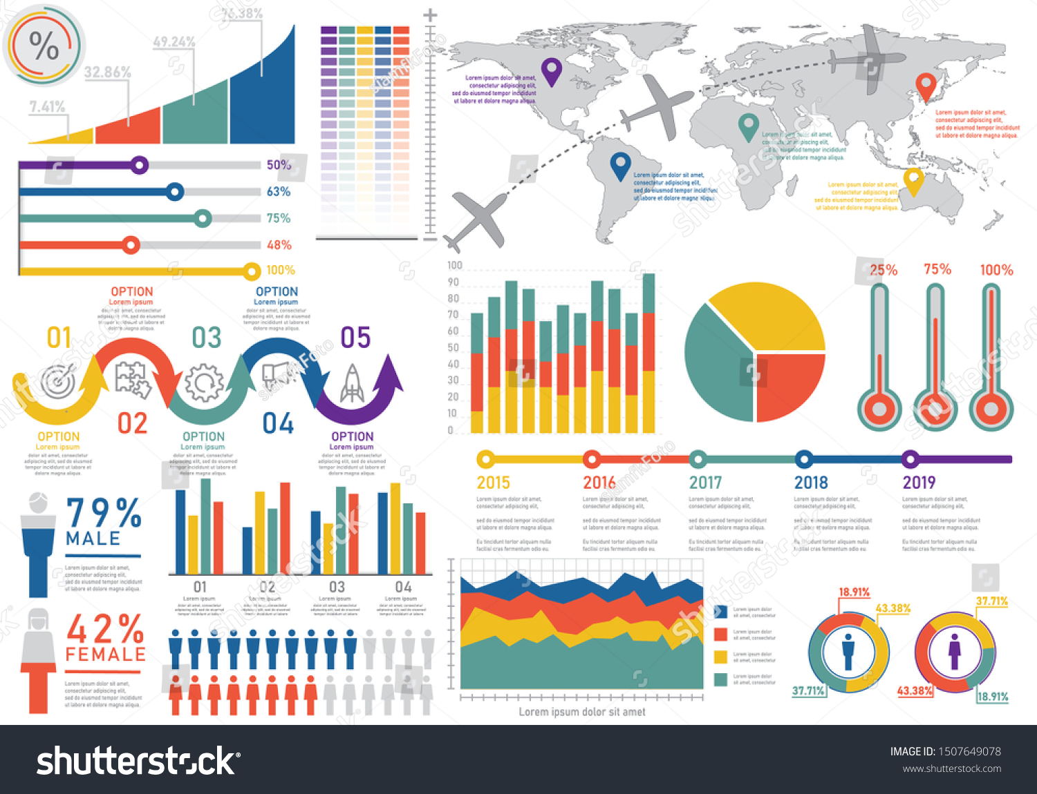

Slide 9
Conclusion:
-The Airline Passenger Satisfaction data set provides many insights into the factors that contribute to passenger satisfaction and dissatisfaction in air travel, which can be used by airlines to improve their services and enhance their customers’ travel experience. Our analysis of the data set has revealed several important findings. We found that there were many relationships between overall passenger satisfaction and the variables tested.
- we found that most of the features were in fact associated with passenger satisfaction. From here, we used a mosaic plot and a chi-square test of independence to find that satisfaction and customer type are dependent, and overall satisfaction tends to be significantly higher for loyal customers, and lower for disloyal customers. Upon inspecting how flight distances and age demographics are related to satisfaction.
-we found that both age and flight distance are in fact dependent on flight satisfaction. Passenger satisfaction seems to be associated with passengers between the ages of around 30 to 60 years old, and for passengers outside of this range they tend to be more dissatisfied. Relatively speaking, shorter flight distances have much more passenger dissatisfaction, and longer flight distances have higher passenger satisfaction. Next, when we analyzed how delays impact customer overall satisfaction with the timing of their flights using a heat map, unsurprisingly we found that there is a strong linear relationship between arrival and departure delays, and that longer delays are associated with lower satisfaction. Lastly, in our investigation of whether higher class passengers are more satisfied than lower class passengers based on flight distance and age using a heat map, we found that satisfied customers have a stronger relationship between age and class.

